Slide 1
Pre-Live Session 10/11
By Ben Goodwin

Slide 2
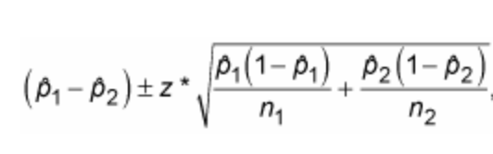
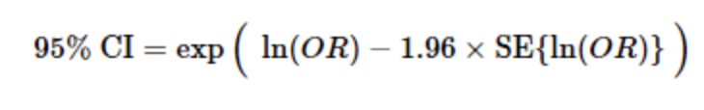
Discussion 1, exercise 18.15
Prospective study, since this experiment the children were enrolled in the experiment to determine crime habits later in life (no predetermined outcomes)
P_hat1=31.15%, P_hat2=48.39% (p_hat2-p_hat1)=17.24%
Difference in proportion: 17.24%
Odds Ratio: (a*d)/(b*c)=(19*30)/(43*32)=0.424
4) 95% CI for Difference in proportion and odds ratio
=(0.3115-0.4839)+/-1.96 *sqrt ((0.3115(1-0.3115)/(61)+(0.4839(1-0.4839)/(62)))
95% CI= (-0.0317%,33.1223%)
CI for difference in proportion contains 0
=exp(ln(0.424)-1.96*0.3755)=(0.2031,0.8854)
CI for odds ratio does not contain 0
I used Chi-square for proportion: 3.782, p-value: 0.0518
Z-statistic for odds ratio: 2.284, p-value: 0.0224

